Slide 1
IHI Call days
How to book your meetings via the B2Match tool

Slide 2

Book your meetings in 4 easy steps
1. Make yourself available
2. Look for partner on the participants or organisation tab
3. Select date, time, attendees (up to eight per meeting), add message
4. Send the meeting request and wait for the reply
Our matchmaking platform allows you to book meetings at any time with any of the participants.
In fact, it will be permanently available for this and future calls

Slide 3
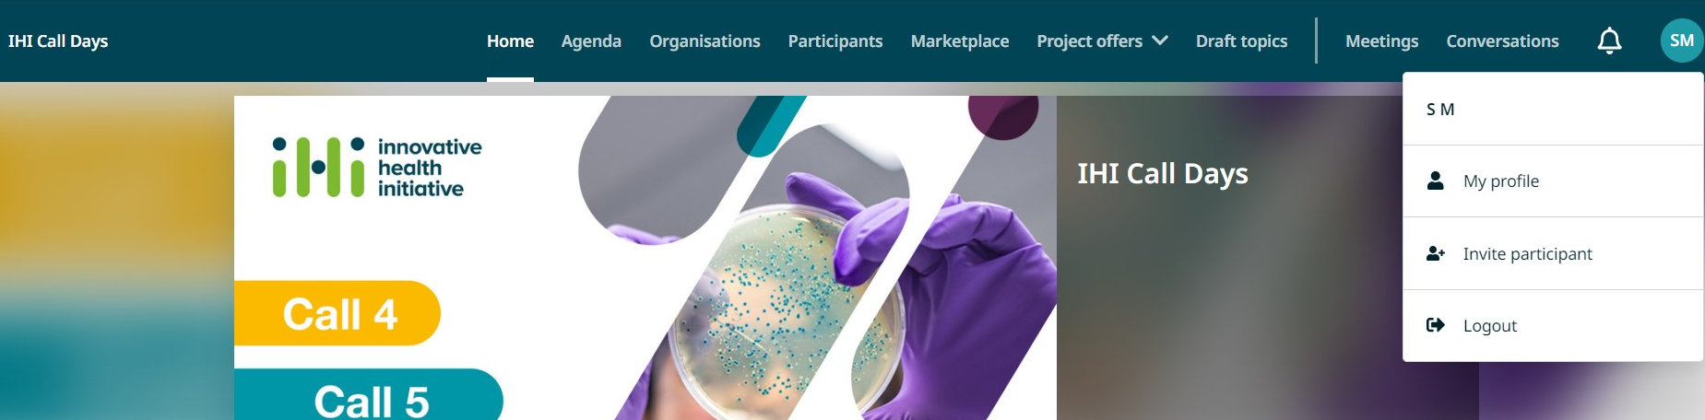
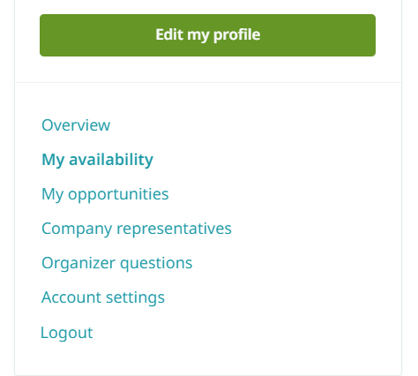
Make yourself available
1. Go to “My profile”
2. Select “My availability”

Slide 4
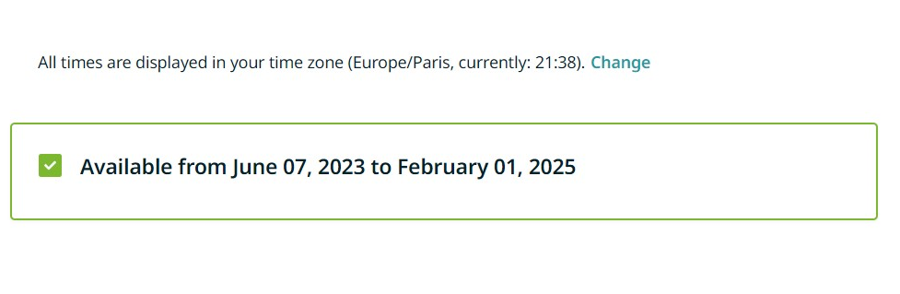
Make yourself available (cont.)
Select if you would like to be available for meetings:
From 07 June 2023 to 01 February 2024

Slide 5
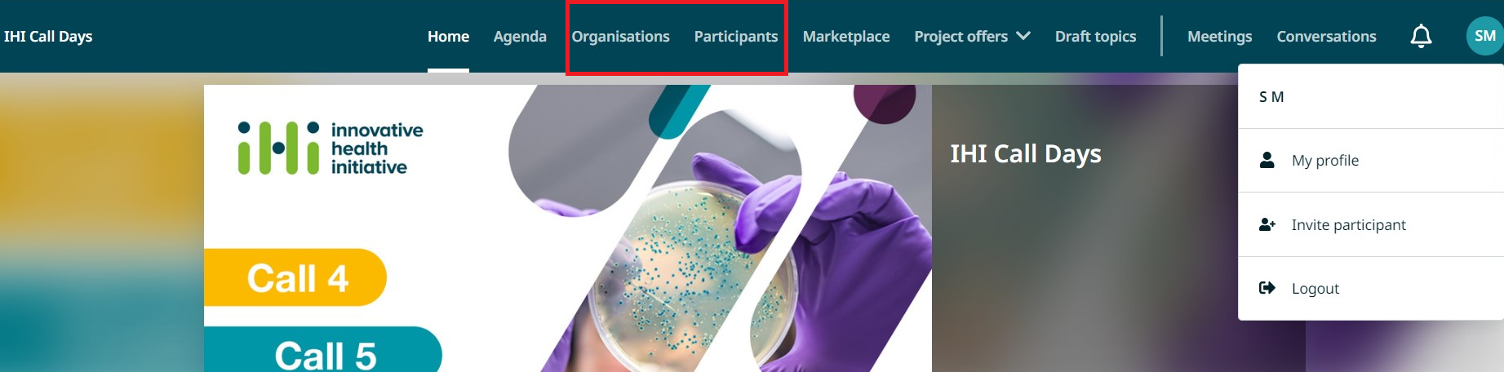
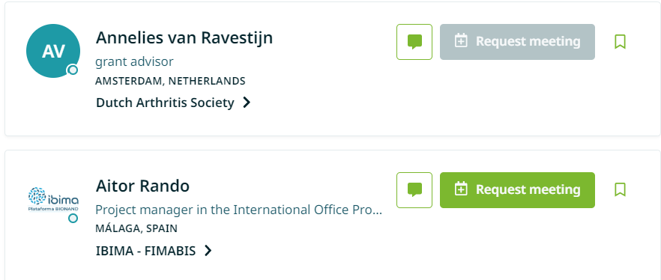
Look for partners
On the participants or organisations tab
If a participant is available for meeting on the same timeslots that you selected they will show in green

Slide 6
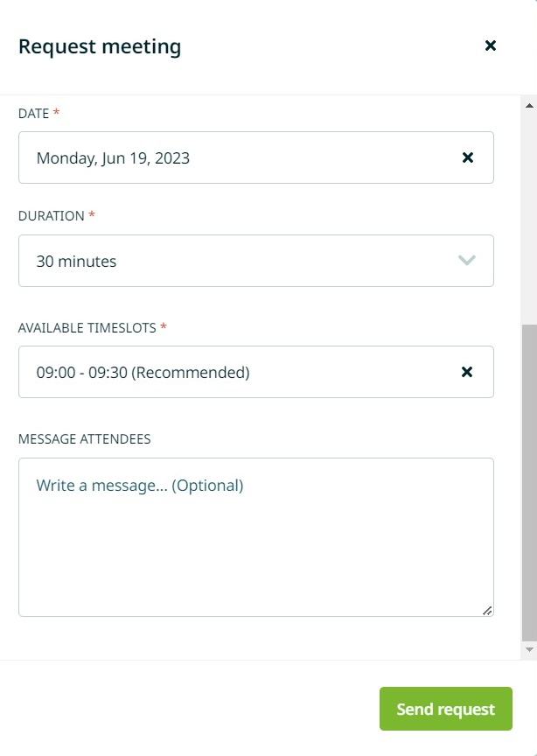
Select date, time, attendees
(up to eight per meeting), add message
Select the following options
Date
Meeting Duration
Check the Available timeslots
Message attendees (optional)

Slide 7
Send Messages to other participants
You can also contact other participants via the message icon

Slide 8
For any questions please contact us at:
events@ihi.europa.eu

